Slide 1
Dates

Slide 2
Introduction to lubridate

Slide 3
Creating Date-Time Objects
ymd(): is a function used to create a date object from year, month, and day components.
my_date <- "2023-09-15"
class(my_date) Output:
my_date <- ymd(my_date)
class(my_date) Output:

Slide 4
2. mdy(): is a function used to create a date object in a month-day-year format.
my_date2 <- "12-14-2023"
my_date2 <- mdy(my_date2)
my_date2
Output:

Slide 5
3. ymd_hms(): creates a date-time object with hours, minutes, and seconds.
my_datetime <- "2023-09-15 14:30:45"
my_datetime <- ymd_hms(my_datetime)

Slide 6
Extracting Components
my_date <- ymd("2024-10-30")
Extract year
year(my_date) Output:
Extract month
month(my_date) Output:

Slide 7
Extracting Components
my_date <- ymd("2024-10-30")
Extract day
day(my_date) Output:
Extract day of the week (Sunday: 1, Monday: 2, etc.)
wday(my_date) Output:

Slide 8
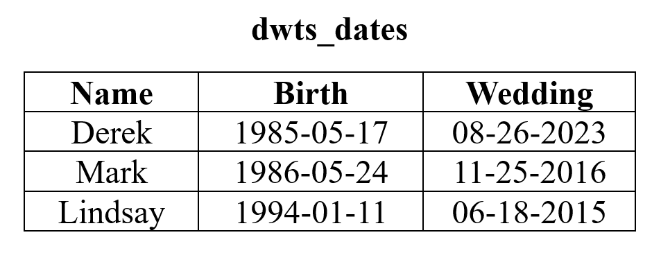
Example with a Dataframe
class(dwts_dates$Name) Output:
class(dwts_dates$Birth) Output:
class(dwts_dates$Wedding) Output:

Slide 9
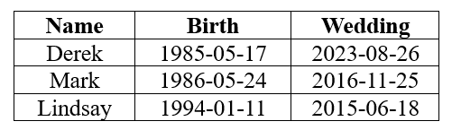
dwts_dates <- dwts_dates %>%
mutate(Birth = ymd(Birth),
Wedding = mdy(Wedding))
class(dwts_dates$Name) Output:
class(dwts_dates$Birth) Output:
class(dwts_dates$Wedding) Output:

Slide 10
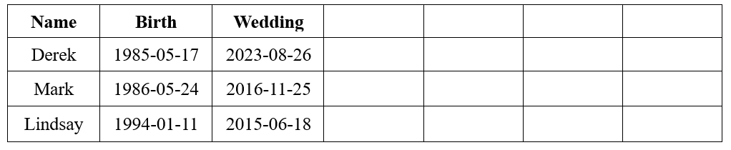
dwts_info <- dwts_dates %>%
mutate(Year = year(Birth),
Day = day(Wedding),
Month = month(Wedding),
Day_Week = wday(Wedding))

Slide 11
Arithmetic with Date-Times

Slide 12
Adding Days
my_date <- ymd("2024-10-30")
new_date <- my_date + days(7)
new_date
Output:

Slide 13
Finding Time Difference
my_date <- ymd("2024-10-30")
my_date2 <- ymd("2024-11-06")
Find the time difference between my_date and my_datetime
diff <- my_date2 - my_date
diff
Output:

Slide 14
Use difftime when the date includes time
time1 <- ymd_hms("2023-09-15 08:30:00")
time2 <- ymd_hms("2023-09-15 12:45:30")
To calculate the time difference in seconds
difftime(time2, time1, units = "secs")
Output:
as.numeric(difftime(time2, time1, units = "secs"))
Output:

Slide 15
Use difftime when the date includes time
time1 <- ymd_hms("2023-09-15 08:30:00")
time2 <- ymd_hms("2023-09-15 12:45:30")
Calculate the time difference in hours
difftime(time2, time1, units = "hours")
Output:
as.numeric(difftime(time2, time1, units = "hours"))
Output:

Slide 16
Finding Intervals
start_time <- ymd_hms("2023-09-15 08:30:00")
end_time <- ymd_hms("2023-09-15 12:45:30")
interval(start_time, end_time)
Output:

Slide 17
Formatting Dates
Using format(): you can format date-time objects for display

Slide 18
my_date <- ymd("2024-10-30")
format(my_date, format = "%A") # %A - The day of the week (i.e, Friday)
Output:
format(my_date, format = "%a") # %a - The day of the week truncated (i.e, Fri)
Output:

Slide 19
my_date <- ymd("2024-10-30")
format(my_date, format = "%B") # %B - The full name of the month (i.e September)
Output:
format(my_date, format = "%b") # %b - The name of the month truncated (i.e., Sep)
Output:

Slide 20
my_date <- ymd("2024-10-30")
format(my_date, format = "%D") # %D - The date in month/day/year format.
Output:
format(my_date, format = "%d") # %d - The number of the day
Output:

Slide 21
my_date <- ymd("2024-10-30")
format(my_date, format = "%Y") # %Y - The year with four digits
Output:
format(my_date, format = "%y") # %y - The year with two digits
Output:

Slide 22
my_date <- ymd("2024-10-30")
format(my_date, format = "%m") # %m - The number of the month
Output:
Suppose you want it to be "Friday, September 15, 2023"
format(my_date, format = "%A, %B %d, %Y")
Output:

